Slide 1
Support Vector Machine(SVM)

Slide 2
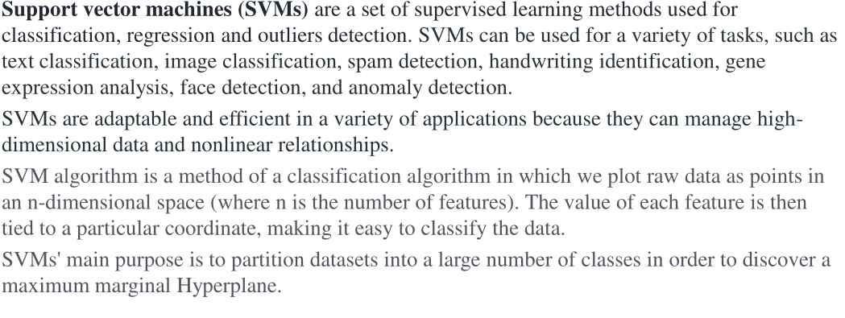

Slide 3
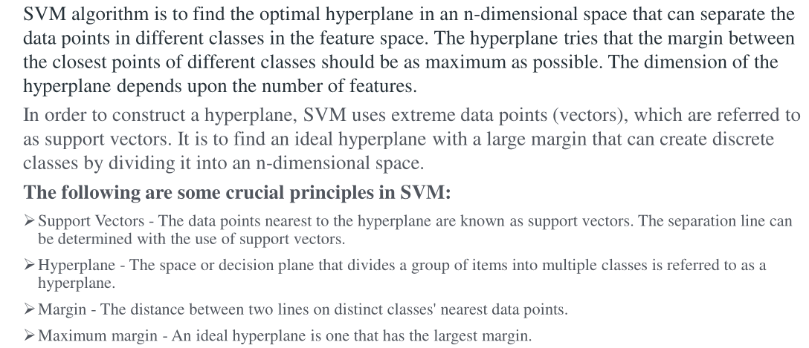

Slide 4
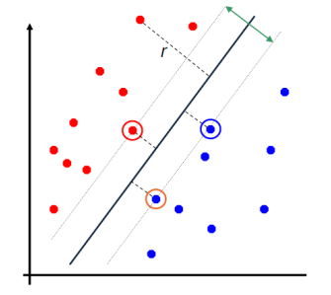
After training, the parameter of the linear model, the weight vector, can be written down
in terms of a subset of the training set, which are the support vectors.
In classification, these are the cases that are close to the boundary and as such, knowing
them allows knowledge extraction:

Slide 5
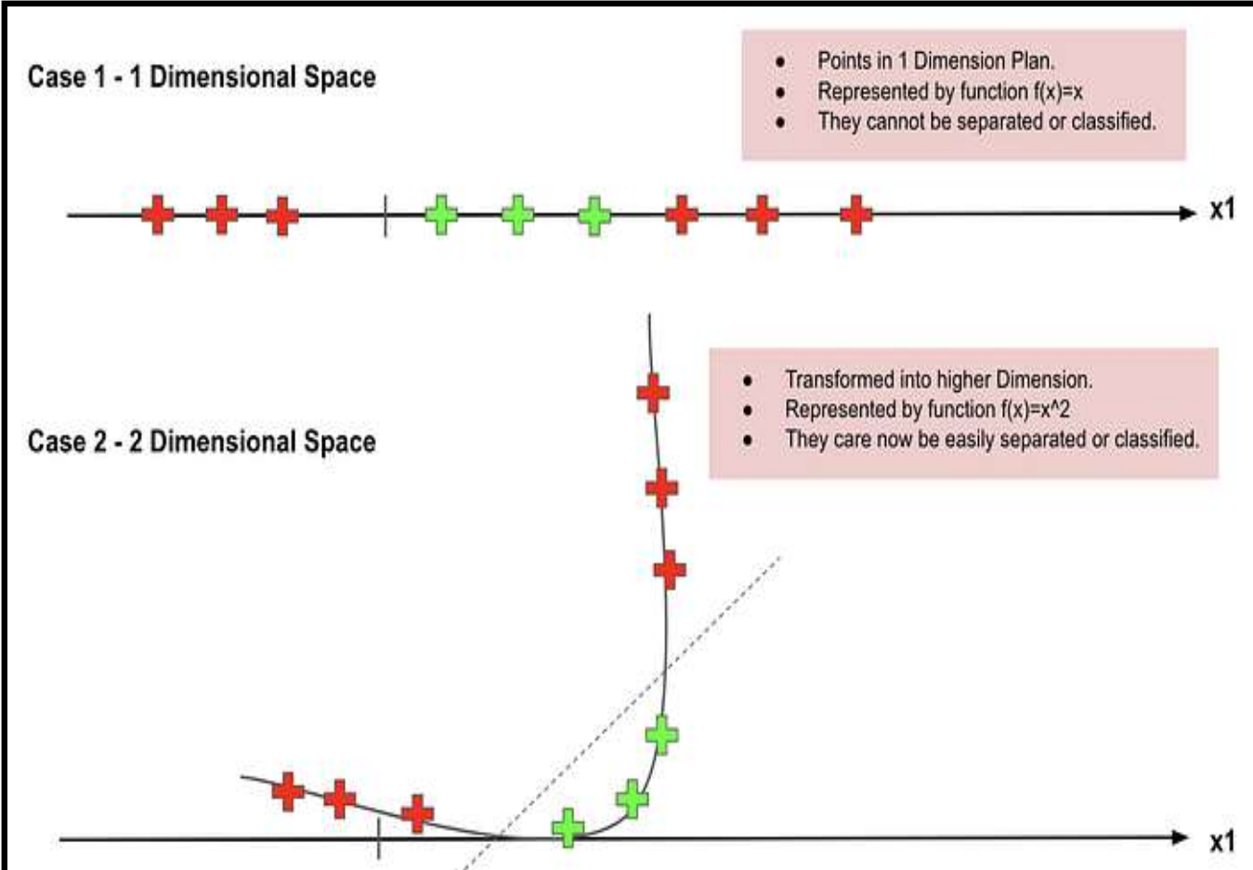

Slide 6
SVM chooses the extreme points/vectors that help in creating the hyperplane.
These extreme cases are called as support vectors, and hence algorithm is termed as Support Vector Machine.
Data points closest to the hyperplane. They influence the position of the boundary.

Slide 7
Support vectors are special because they are the training points that define the maximum margin of the hyperplane to the data set and they therefore determine the shape of the hyperplane

Slide 8
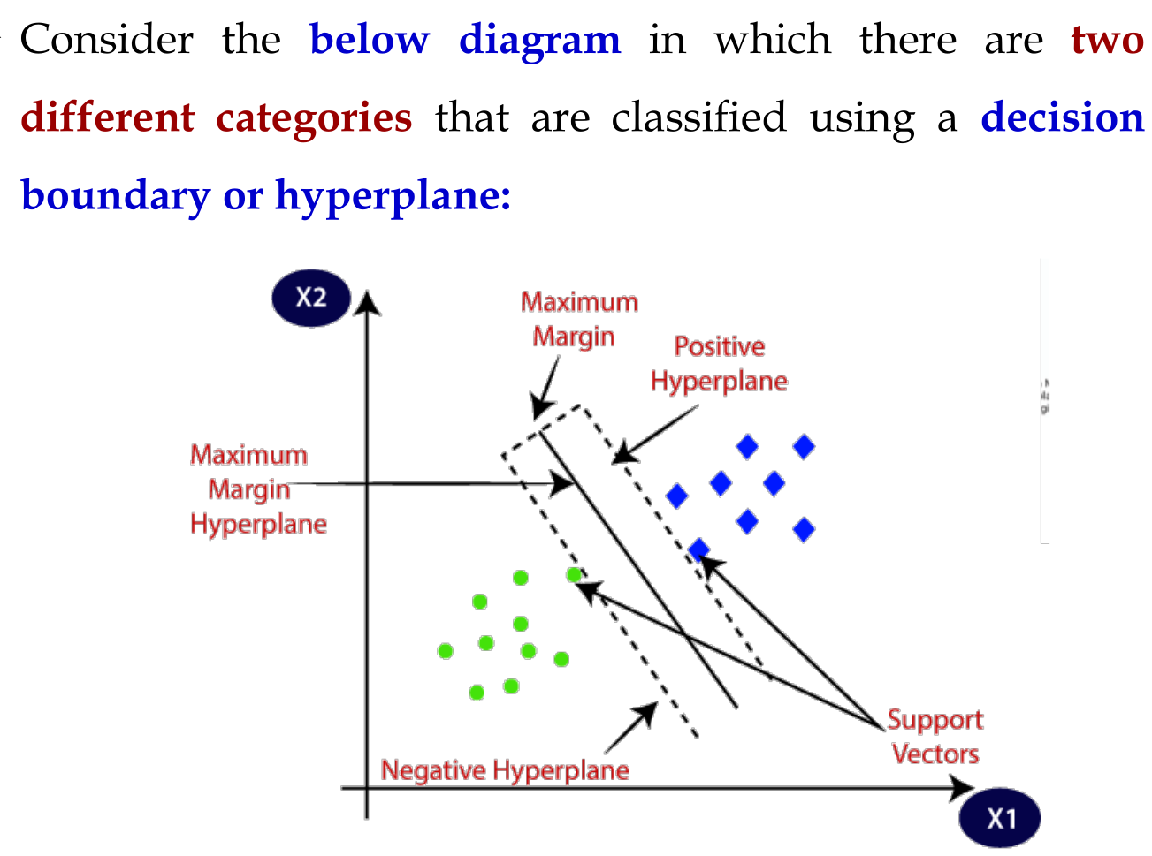

Slide 9
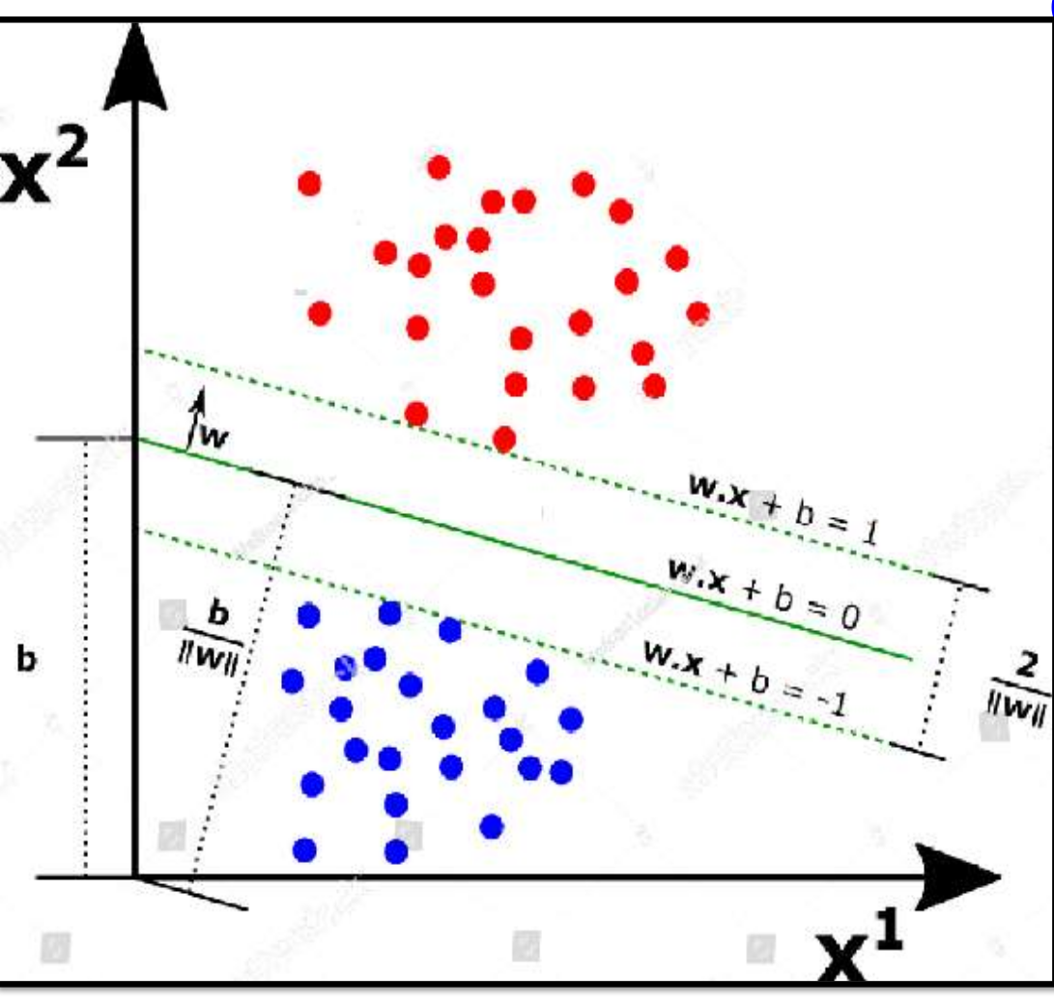

Slide 10
The distance of the vectors from the hyperplane is called the margin, which is a separation of a line to the closest class points.
We would like to choose a hyperplane that maximizes the margin between classes.

Slide 11
The distances of the gap in-between two classes is 2/|w|. we want to maximize this distance.
If we want to find a line that perfectly separates the two classes, we call this type of SVM cost function as Hard- Margin cost function.

Slide 12
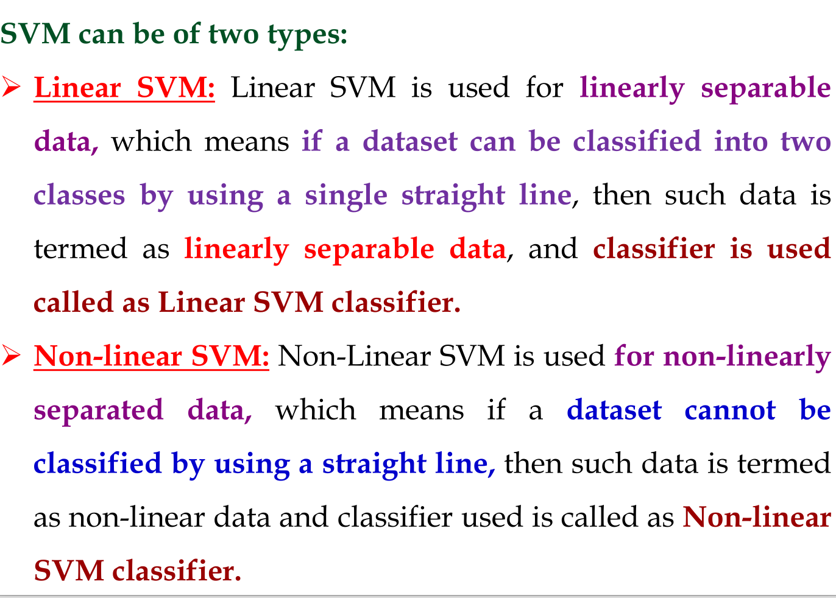
Types of SVM

Slide 13
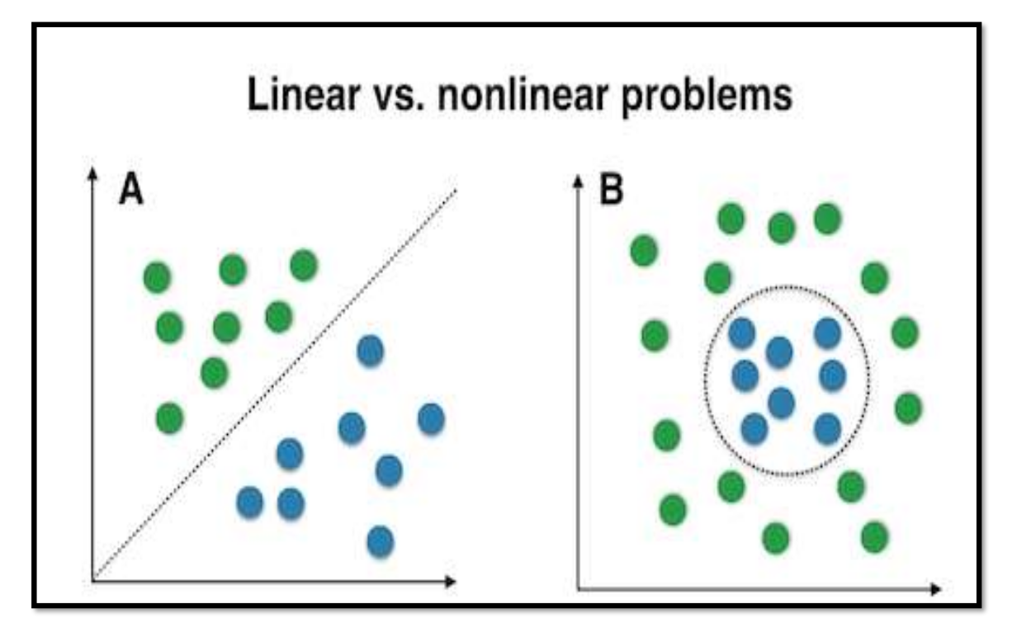

Slide 14
Linear SVM Definition
Used when data is linearly separable
Find w and b such that: w·x + b = 0

Slide 15
Linear SVM Formula
Decision function: f(x) = w·x + b
Constraints: yi(w·xi + b) ≥ 1
Objective: minimize ||w||²

Slide 16
Decision function: f(x) = w·x + b
How classification works:
If f(x)>0 → Class +1
If f(x)<0 → Class −1

Slide 17
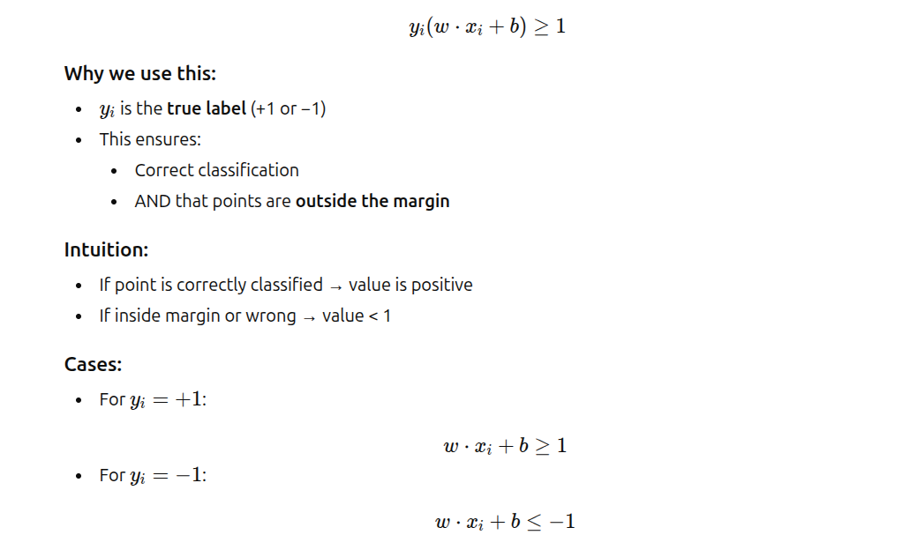
Constraint

Slide 18
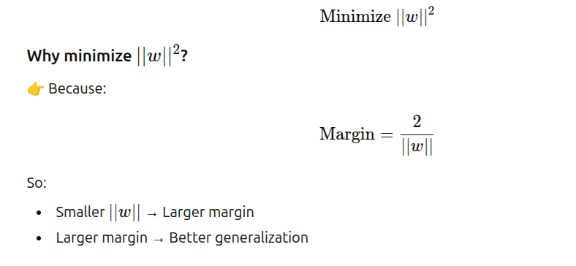

Objective Function

Slide 19
Non Linear SVM
Used when data is not linearly separable.
Uses kernel trick.

Slide 20
Kernel Trick
Avoid explicit transformation
Use kernel function K(xi, xj)

Slide 21
Kernel Trick
Transforms data into higher dimensions.
Common kernels:
- Linear
- Polynomial
- RBF

Slide 22
Common Kernels
Linear: K(x,y)=x·y
Polynomial: K(x,y)=(x·y + c)^d
RBF: K(x,y)=exp(-γ||x-y||²)

Slide 23
Non-Linear SVM Formula
Decision: f(x)=Σ αi yi K(xi,x) + b
αi are Lagrange multipliers

Slide 24
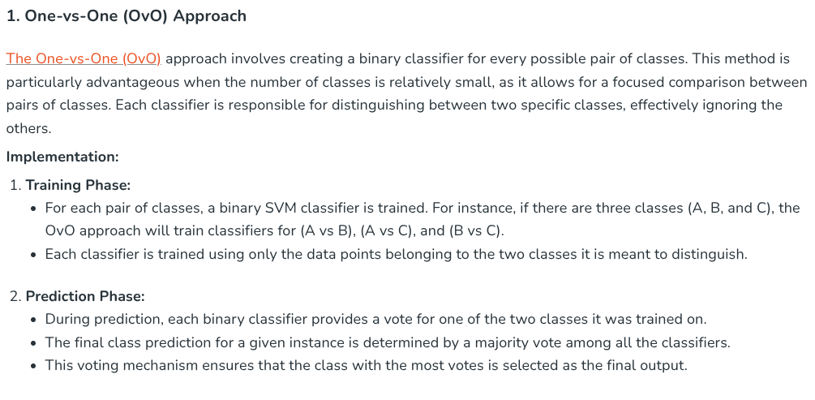
Multi-Class Classification With SVMs - Strategies for Multi-class Classification with SVM

Slide 25
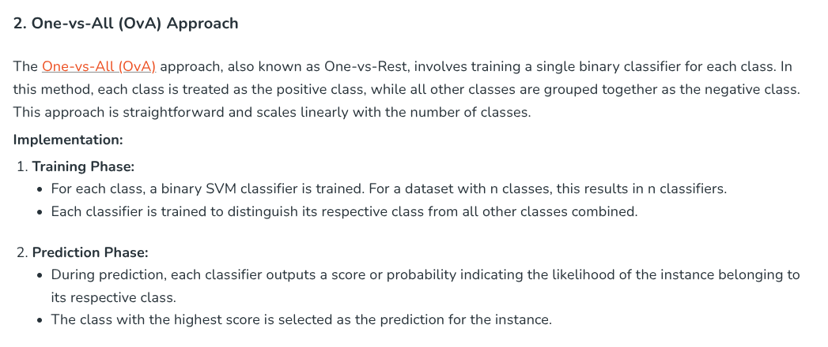

Slide 26
Advantages
Effective in high dimensions.
Works well with clear margin separation.
SVM is one of the most memory-efficient classification algorithms.
Effective on datasets with multiple features

Slide 27
Disadvantages
Sensitive to noise.

Slide 28
Applications
Text classification
Image recognition
Bioinformatics

